Slide 1
Microprocessor Architecture ECE4375 / 5375
Dr. Argenis Bilbao
Spring 2026

Slide 2
Presentation Outline
Virtual Memory
Memory Management Unit (MMU)
Swapping

Slide 3
Virtual Memory
Basic Idea
Allow the OS to give out more memory to software programs than its available in the system!
How is this Possible?
Keep recently used stuff in physical memory.
Move less recently used stuff to the disk drive.
Keeping this all transparent to the tasks/processes. These memory operations are handled by the OS.
CPU executes process B while process A waits for its memory transaction to complete. (Of course, CPU hardware cache helps a lot here).

Slide 4
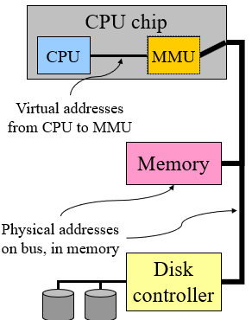
Virtual Memory
Program uses virtual addresses.
Addresses local to the process.
Hardware translates virtual addresses to physical addresses.
Translation is done by the Memory Management Unit (MMU).
On the same chip as the CPU cores.
Only physical addresses leave the CPU/MMU combination.

Slide 5
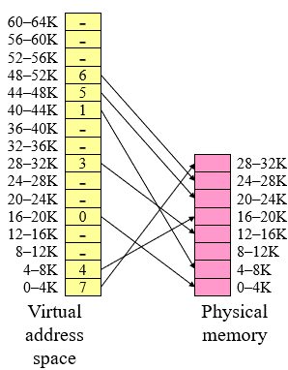
Virtual Memory
Virtual addresses mapped to physical addresses.
A unit of mapping is called a page.
Page table entry (PTE) contains translation for a single page.
Table translates virtual page number to physical page number.
Not all virtual memory has a physical page.
Not every physical page need to be used.

Slide 6
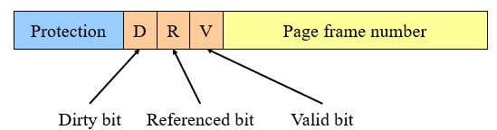
Virtual Memory – Page Table Entry
Each Entry Contains:
Valid bit.
Page frame number.
Referenced bit (page in physical memory)
Dirty bit.
Protection information!

Slide 7
Virtual Memory Mapping
Split address from CPU into two pieces.
Page number (p).
  Index into page table.
  Page table contains base address of page in physical memory.
Page offset (d).
  Added to base address to get actual physical memory address.

Slide 8
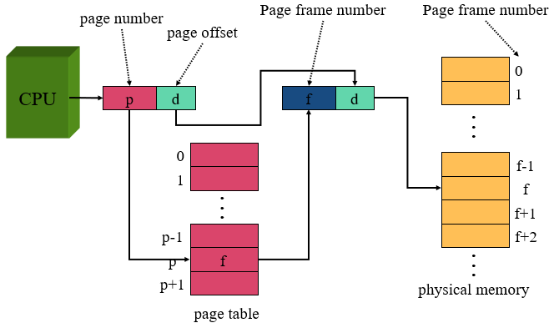
Virtual Memory Mapping

Slide 9
Implementing Page Tables in Hardware
Page table resides in main (physical) memory.
CPU uses special registers for paging.
  Page table base register (PTBR) points to the page table
  Page table length register (PTLR) contains length of page table (used to restrict the maximum number of logical addresses)
Translating an address requires two memory accesses
  First access reads the page table entry (PTE).
  Second access reads the data / instruction from memory
To reduce the number of memory accesses:
  Eliminate the first access by keeping a hardware cache called a translation lookaside buffer (TLB) of recently used page table entries.
  Eliminate the second access by using the regular CPU cache (L1, L2, L3)

Slide 10
Sources
http://www.eecs.harvard.edu/cs146-246/
Assigned Textbook
https://cs.pitt.edu/

